Slide 1
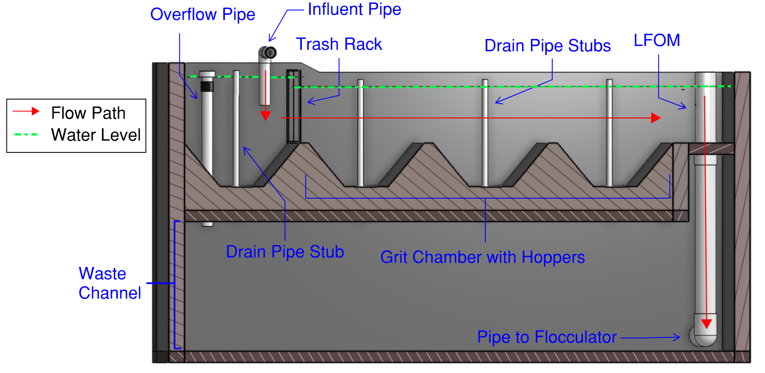
Introduction to Entrance Tank (Onshape Model)

Slide 2
Entrance Tank Functions
Remove leaves and other debris to prevent clogging of the diffusers in the clarifier inlet (smallest opening that dirty water must pass through!)
Remove grit to prevent accumulation in the flocculator (otherwise you have to shovel it out of the flocculator)
Measure the incoming flow rate so that operators can make adjustments and respond to changes in water demand
Inject the coagulant (our designs don’t show this yet, coming soon!)

Slide 3
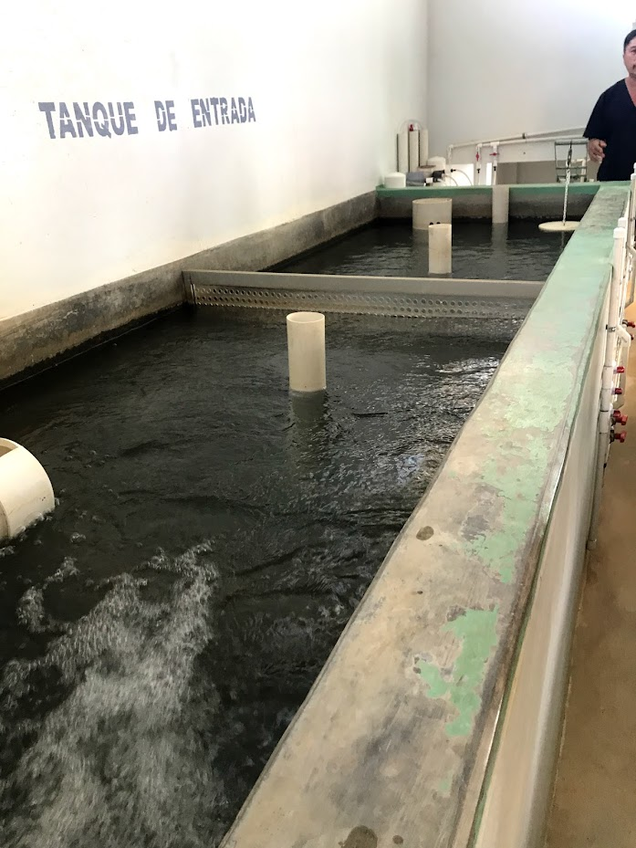
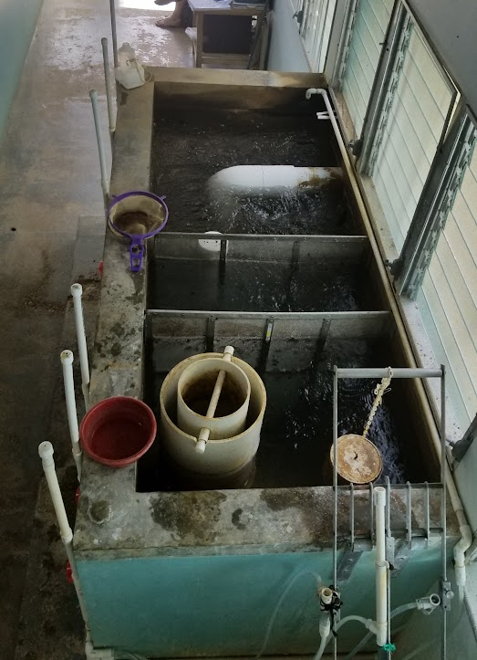
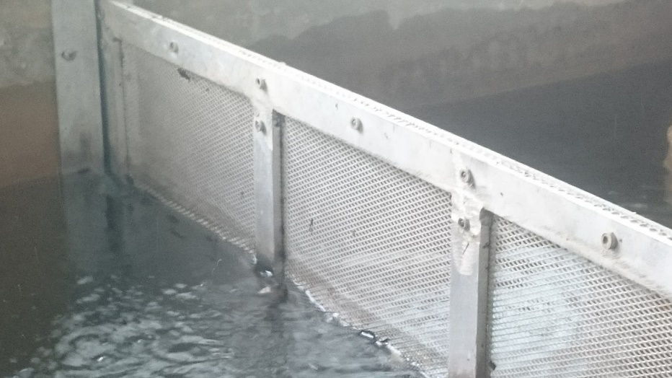
Keep on moving, nothing interesting here!
Mess this up and the plant will be a pain to operate!
Linear Flow Orifice Meter
Those holes are too big!
Lift this pipe to open the drain to discharge accumulated grit

Slide 4
FeatureScript Demo
Start with a copy of Entrance Tank template
Make a rectangle in a sketch and define a config variable for a side
Delete config
The feature list is just code being executed
Placing the feature in a part studio is the only way to execute featurescript (delete it, show variables, put it back)
Define a new variable in the design map (residence time)
Show variable name options
Monitor the Part Studio to show errors
Use the featurescript notices to track errors
Create H as an input
Calculate VOL and then L, W
Show how a variable can be used in any subsequent feature
Break the code by changing a variable name
Create a rectangular solid

